Slide 1
Chi-square
Introduction to Data Analytics Day 9

Slide 2
Understanding Data Distributions
When analyzing data, it's important to understand the distribution of the data. The distribution refers to how the data is spread out or clustered around certain values or ranges.
By examining the distribution, we can gain insights into the characteristics and patterns of the data, which can be useful in making informed decisions and predictions.

Slide 3
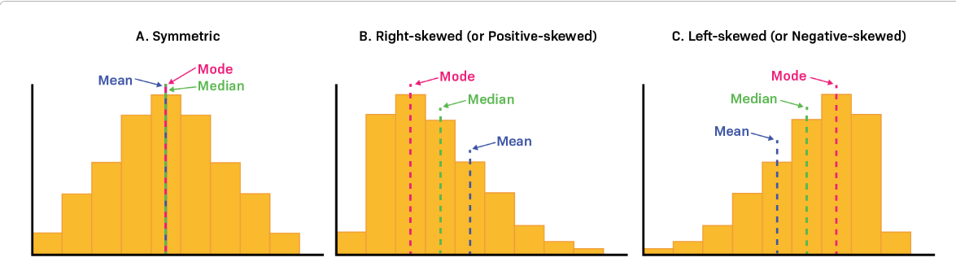
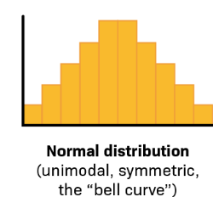
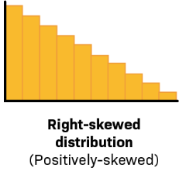
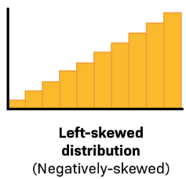
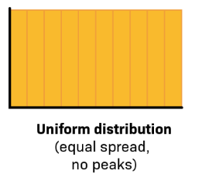
Types of distributions

Slide 4
What and Why Chi-Square
A Chi-square (χ2) test is a hypothesis testing method used measure of the difference between the observed and expected frequencies of the outcomes of a set of events or variables.
We use a chi-square test for independence when we want to formally test whether or not there is a statistically significant association between two categorical variables.
The hypotheses of the test are as follows:
Null hypothesis (H0): There is no significant association between the two variables.
Alternative hypothesis: (Ha): There is a significant association between the twovariables

Slide 5
Types of Chi-Square
Chi-square test of independence: This is the most common application, used to determine if two categorical variables are independent (no association) or related. For example, analyzing if there's a relationship between website traffic source and purchase behavior.
Goodness-of-fit test: This checks if the observed frequencies of a categorical variable match an expected distribution. Imagine testing if customer satisfaction ratings align with the company's expectations.

Slide 6
Feature selection and model evaluation:
Chi-square feature selection: This identifies features in a dataset that are significantly associated with the target variable, aiding in model building and reducing complexity.
Chi-square test for model comparison: This compares the fit of two different models on the same data, helping choose the more suitable one.
Contingency table analysis: Examining relationships between multiple categorical variables simultaneously.
Testing homogeneity: Checking if distributions of a categorical variable are the same across different groups.
Exploratory data analysis: Identifying patterns and relationships in categorical data visually.

Slide 7
Areas of Application
Marketing: Analyzing the effectiveness of ad campaigns across different demographics or platforms.
Finance: Assessing the risk of loan defaults based on borrower characteristics.
Healthcare: Investigating the association between specific medical conditions and lifestyle factors.
Social sciences: Examining relationships between voting behavior and socio-economic factors

Slide 8
When to Use Chi-Square Tests
Categorical data analysis.
Testing hypotheses about distributions or relationships in nominal data.
Conditions for using the test: expected frequencies should be at least 5 for each category.

Slide 9

Calculating the Chi-Square Statistic
Oi​ is the observed frequency
Ei​ is the expected frequency.

Slide 10
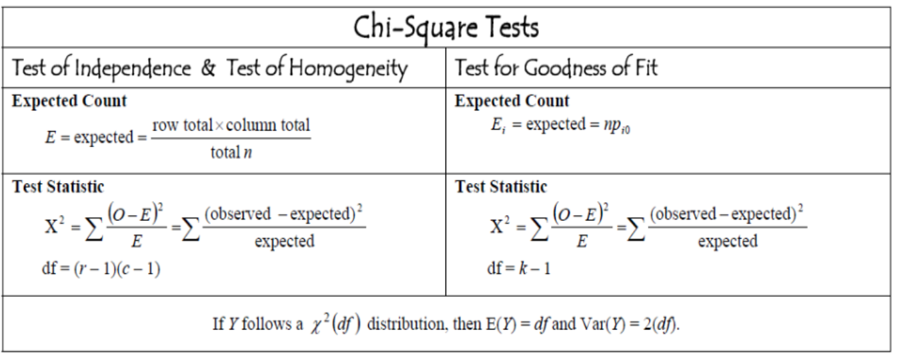
Ch-Square tests

Slide 11
Degrees of Freedom
These are the number of independent pieces of information available to estimate in your analysis. It essentially tells you how many values can vary freely before constraints are imposed.
They reflect the number of independent values used to estimate parameters like means, variances, or regression coefficients.
Goodness fit= K-1
Test of independence-df = (r - 1)(c - 1), where r is the number of rows and c is the number of columns.

Slide 12
Step of calculating Chi-square
1.Create a table of the observed and expected frequencies.
2.Calculate the chi-square value from your observed and expected
frequencies using the chi-square formula.
3.Find the critical chi-square value in a chi-square critical value table or using statistical software.
4.Compare the chi-square value to the critical value to determine which is larger.
5.Decide whether to reject the null hypothesis. Reject the null hypothesis if the chi-square value is greater than the critical value. If you reject the null hypothesis, you can conclude that your data are significantly different from what you expected.

Slide 13
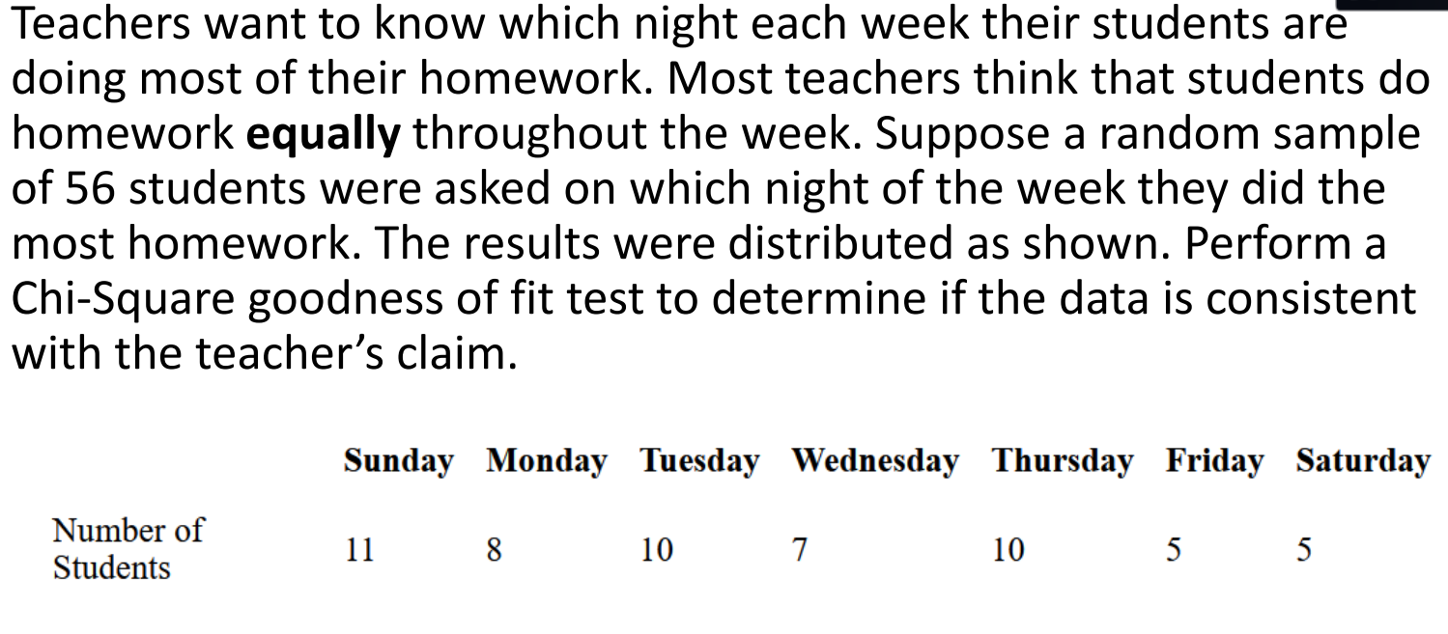

Slide 14
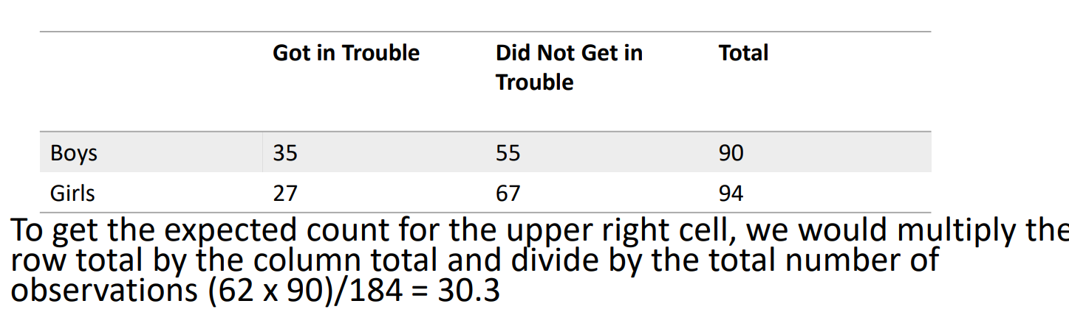
Example 2
Below is the table documenting the raw scores of boys and girls and their respective behavior issues (or lack thereof): use a chi-square test to determine whether there is a relationship between gender and getting in trouble at school

Slide 15
Exercise
PFA

